Slide 1
Assignment 6
Poornima Ramachandran

Slide 2
Novel Contribution
With the rapid increase in population across the world. Environment has been a main topic of discussion in many meetings and conferences across the world.
The recent conference in Paris the main emphasis of the was on air pollution .
Air pollution has topped the list of the factors which affect the environment.

Slide 3
Novel Contribution
Air pollution is a the presence or introduction into the air of a substance which has harmful or poisonous effects.
With the increase spending capacity of the people across the world . The number of vehicles on the street has exponentially.
Research shows that 70 percent of the air pollution is caused by the vehicles who search for parking spaces.
Hence a lot of emphasis is given to the parking infrastructure in big cities .

Slide 4
Novel Contribution
Hence we intend with the data we have the to work on impact of various factors involved in parking analytics which will affect the ozone layer in the environment.
In the search we will study the significant factors which affect the ozone layer in the environment.

Slide 5
Novel Contribution
The 2 main contributions of our research will be as follows:
Preventive measures to control the air pollution
Building better parking infrastructures.

Slide 6
Novel Contribution
We will also be working as the on forecasting the affect of the delay in finding a parking spot on the ozone count in the environment
The reason we chose the ozone layer as this is the main component which impacts the environment.
If the ozone content increases the impact of the ultra violent rays on earth will increase and this will result in higher temperatures .
This will result in Global Warming .

Slide 7
Work By Competitors
There has been a good number of work done by in parking analytics so far
The researchers has employed a number of methods in parking analytics. They are
Blind Search method
Parking Information Systems
Buffer Parking Information System
Code Based Parking Reservation Systems.

Slide 8
Work By Competitors
Blind Search Method :
In this method the driver will get information about the number of parking places available in the areas where he/she is driving .
The driver can drive to the parking location based on the availability.
The drawback of this method is that driver will have to drive around till he/ she finds an empty parking spot.

Slide 9
Work By Competitors
The next level of research concentrated on the solving the drawbacks of the previous research.
This research concentrated on combing the smart phones with the parking information systems to ensure the citizens have the parking information systems.
The Parking Information System is connected to an app on the smart phone which will accurately spot where the parking is available .
The driver can drive to the shown parking spot.
The drawback of this was that the app doesn’t give if the information whether the parking spot is filled before the driver arrives at the spot and also on busy days we will again go back to blind search method.

Slide 10
Work By Competitors
Buffer Parking Information systems (BPIS)solve the problems or drawbacks of the Parking Information systems.
The BPIS shows only 80 percent of the parking spots available in a particular area where the driver is searching the parking .
In event of excessive request for the parking slots the system will release the information about the remaining 20 percent of the parking slots to accommodate the demand of the parking slots.
The drawback of this method is still the fact the there no information given on the parking which are getting filled to the driver to find an alternate parking.

Slide 11
Work By Competitors
The latest research which was done on the Parking Information Systems is on Reservation based Parking Information Systems.
In this method the once driver logs in to the app from his smart phone the system will send a quick response code (QR code) to the driver through the Short Messaging Services (SMS).
Once the drivers enters the code in the app the systems reserves the parking slot for the driver for 40 minutes.
The driver gets the confirmation he/she can drive to the spot to get the information.
The draw back of this is that the system does not show the directions to the parking spots.

Slide 12
Work By Competitors
Many researches at the moment are working on the combining the Reservation based parking information systems with the Google Positioning System (GPS) to ensure that drivers drive to correct parking spots they have reserved.

Slide 13
Data
To work on our on our concept we have used 2 data sets of a Smart city in Denmark named Aarhus.
We have used the 1. Parking Data and 2. Pollution Index data .

Slide 14
Data
The Parking Data set consists of the following information
Vehicle count – Which will give us the count requesting for a parking spot
Total Spaces- Total number of spaces available for parking
Garage Code – Garage Code gives the codes of the parking complex in the area where the driver is looking for parking.

Slide 15
Data
The other data set we used for our analysis is Pollution Index.
The data set consists of the following
Sulphur Content – Amount of Sulphur in air
Ozone content - The Ozone content in the environment
Carbon content – Amount of Carbon in the air

Slide 16
Method
I intend use to predict the effect on ozone content in air with the parking information systems.
We will be applying the concept of step wise regression and time series to under the impact on the ozone layer.
The stepwise regression will be used to identify the significant parameters which impact the ozone content in the air
Time series to forecast the impact of ozone layer in the environment

Slide 17
Method
Pseudo Code :
Load the parking data into the system
Load the pollution data into the system
Merge the two data sets In the data frame
Name the data fields.
Take the Ozone count to the dependent variable
Perform the linear regression using lm function on each variable to find the significant parameters.
Check the P values of each parameter
Identify the parameters that affect the ozone count in the model
Plot the graph for the same .

Slide 18
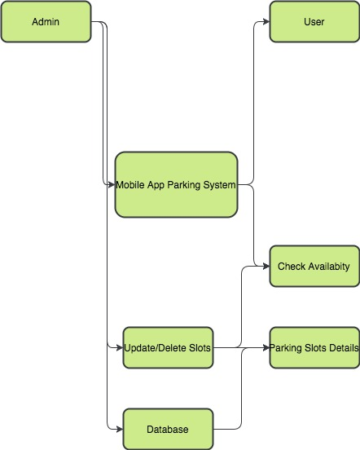
Method

Slide 19
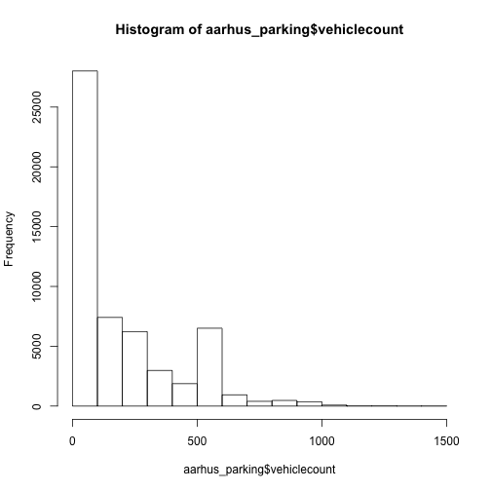
Method Initial analysis

Slide 20
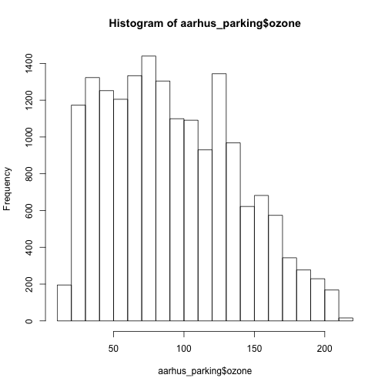
Method Initial Analysis

Slide 21
Method
Future work of my project will be to implement the time series after we identify the significant parameters impact the ozone content in the atmosphere.
Forecasting the information will give clear analysis on how we can plan the control the pollution index of the city and also can help in building the proper infrastructure for parking to reduce the air pollution.

